Slide 1

A Flagship Program of Ministry of Education, GoI
उन्नत भारत अभियान
Unnat Bharat Abhiyan
शिक्षित भारत- सक्षम भारत- स्वस्थ भारत-
संपन्न भारत- आत्मनिर्भर भारत
समावेशी ग्रामीण विकास के लिए उच्च शिक्षण संस्थाओं के ज्ञान, स्वैच्छिक संगठनो के अनुभव और सरकार के संसाधन, के अभिसरण हेतु शिक्षा मंत्रालय की पहल
Unnat Bharat Abhiyan is inspired by the vision of transformational change in rural development processes by leveraging knowledge institutions to help build the architecture of an Inclusive India.

Slide 2


Unnat Bharat Abhiyan: moving towards sustainable rural development and an Atmanirbhar Bharat
उन्नत भारत अभियान
शिक्षित भारत –सक्षम भारत – स्वस्थ भारत – संपन्न भारत- आत्मनिर्भर भारत
Fast-tracking rural livelihood
Unnat Bharat Abhiyan
Indian Institute of Technology Delhi
Email: unnatbharatabhiyaniitd@gmail.com

Slide 3

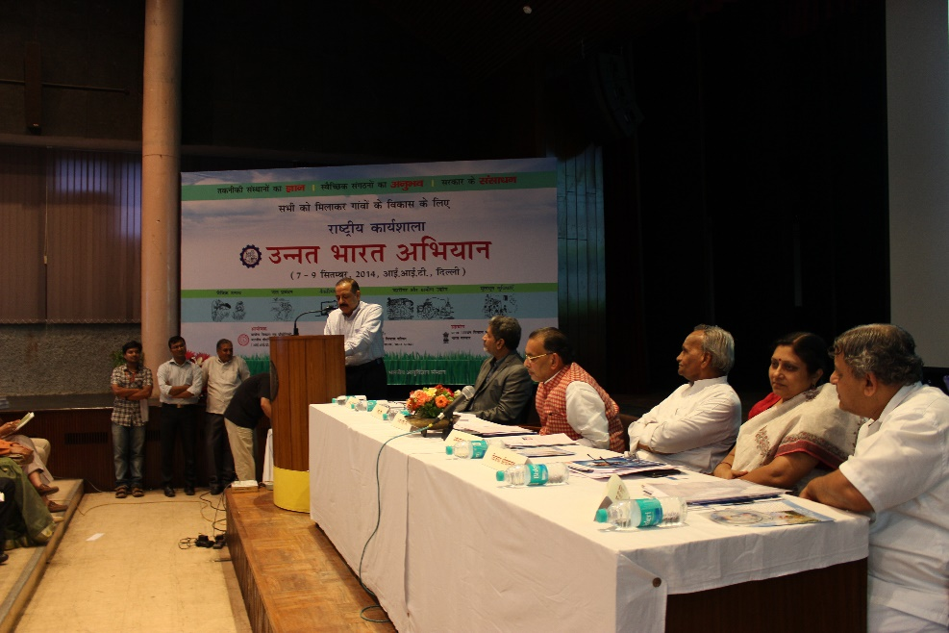
Unnat Bharat Abhiyan
UBA launch workshop, 2014
A flagship program of the MoE, GoI launched in 2014, launched by Shri Pranab Mukherjee,
the then President of India
Inspired by the vision of transformational change in rural development processes by leveraging knowledge institutions to help build the architecture of an inclusive India.
Launch of UBA 2.0, 2018

Slide 4

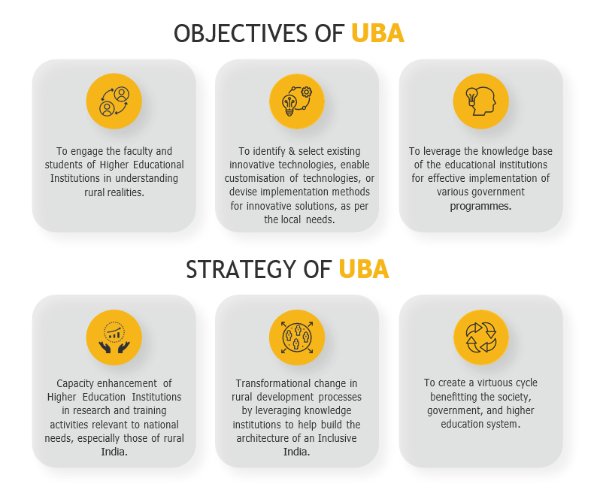

Slide 5
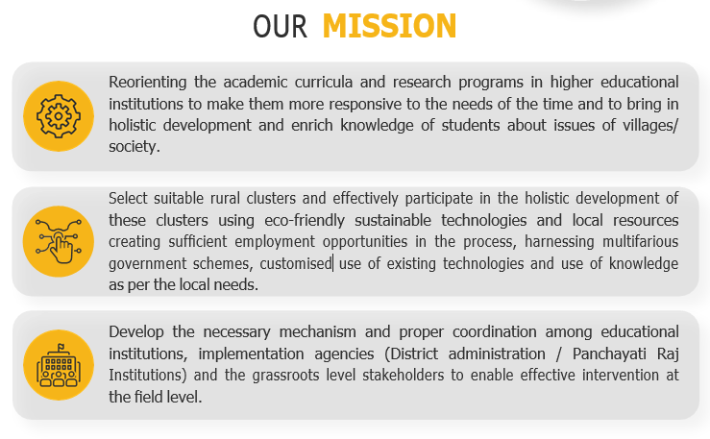

Slide 6

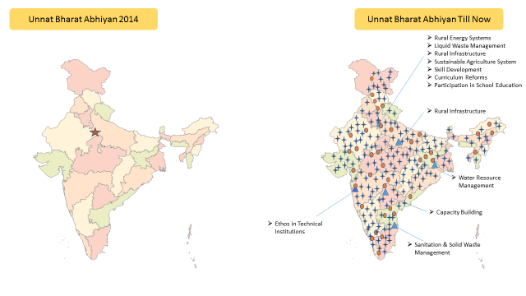
UBA Network
1 NCI
Sustainable Agriculture System
Rural Craft and Artisans Development & Rural Industrialization and Entrepreneurship Development
Rural Energy System
Liquid Waste Management
Skill Development
Curriculum Reforms
Participation in school Education System
45 RCI*
13 SEG**
3229 PIs
Covering All States with 57 Aspirational Districts
*4 more RCIs proposed in Northeast region
** 2 more SEG formed in National Executive Committee on Livelihood and Empowerment

Slide 7
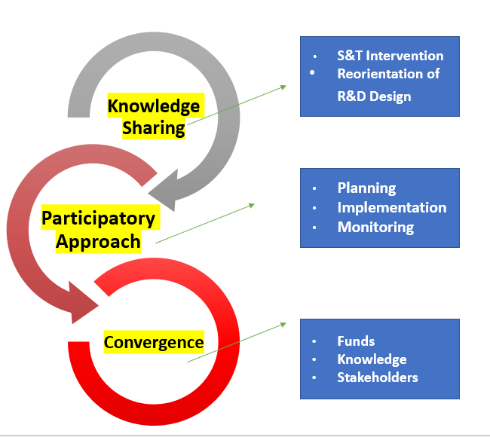
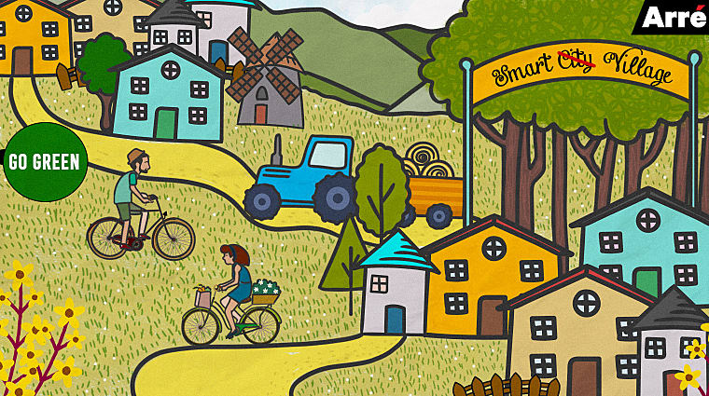
Ethos of UBA

Slide 8
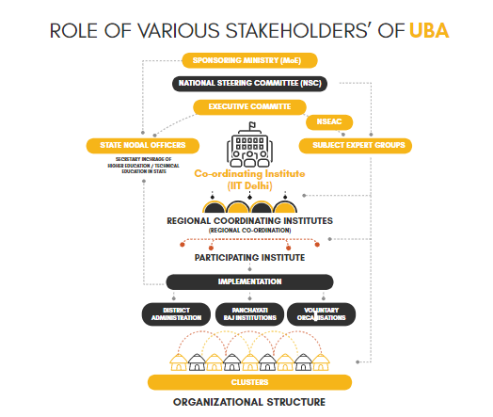

Slide 9
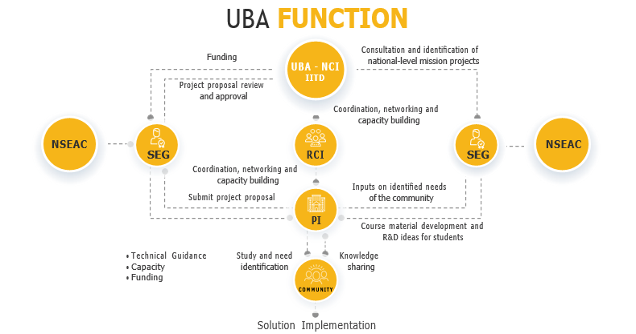

Slide 10


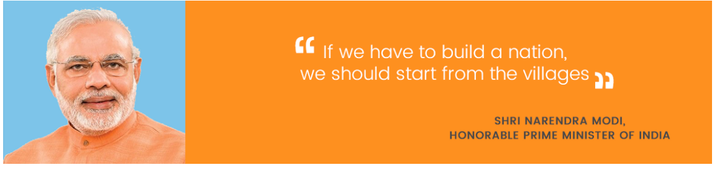
Unnat Bharat Abhiyan resonates with the UN 2030 Agenda and
Atmanirbhar Bharat Abhiyan
Unnat Bharat Abhiyan is striving to transform rural development and make villages self-reliant through initiatives on:
Transforming rural livelihood through S&T interventions
Women empowerment and gender equality
Sustainable food and water production and management
Natural resource management and protection

Slide 11


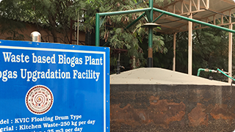
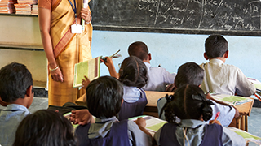

Thematic Areas
Sustainable Agriculture
Water Management
Renewable Energy System
Basic Amenities
Artisans, Industries and Livelihood

Slide 12
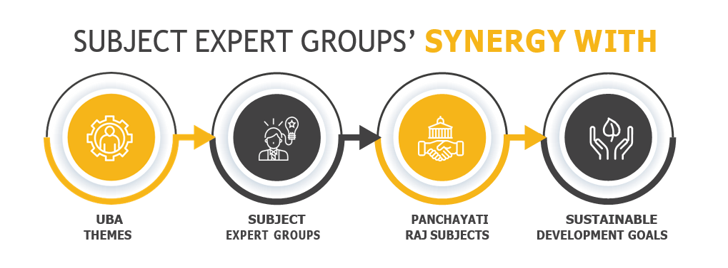

Slide 13
Subject Expert Groups: Synergy with UBA Themes, Panchayati Raj Subjects, and Sustainable Development Goals
Agriculture including agricultural expansion
Animal husbandry, dairying and poultry
Sustainable agriculture systems
Land improvement, implementation of land reforms, land consolidation and soil conservation
Organic Farming
Minor irrigation, water management, and watershed development
Water resource management
Safe water for drinking
Water Management
Fuel and fodder
Rural energy
systems
Rural electrification including distribution of electricity
Renewable Energy
Non-conventional sources of energy

Slide 14
Subject Expert Groups: Synergy with UBA Themes, Panchayati Raj Subjects, and Sustainable Development Goals
Maintenance of community assets
Ethos in technical institutions
Cultural activities
Rural craft and artisans development and rural industrialization and entrepreneurship development
Khadi, village and cottage industries
Markets and fairs
Social forestry and farm forestry
Capacity Building Artisans, Industries and Livelihood
Skill development, entrepreneurship, start-ups, and digital know-how
Small scale industry
Minor forest produce
Capacity building, strategy for convergence, and implementation of various govt. schemes
Welfare of the weaker sections, in particular SC and ST
Women and child development
Family welfare
Social welfare including welfare of the handicapped and mentally retarded
Public distribution system
Poverty alleviation programmes

Slide 15
Subject Expert Groups: Synergy with UBA Themes, Panchayati Raj Subjects, and Sustainable Development Goals
Libraries
Participation in school education
Education including primary and secondary schools
Adult and non-formal education
Roads, culverts, bridges, ferries, waterways and other means of communication
Rural infrastructure
Rural housing
Sanitation and solid waste management
Basic Amenities
Health and sanitation including hospitals, primary health centers and dispensaries
Liquid waste management
Curriculum reforms and educational institutions social responsibility
Technical training and vocational education

Slide 16
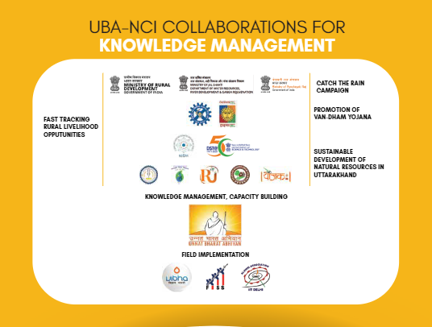

Slide 17
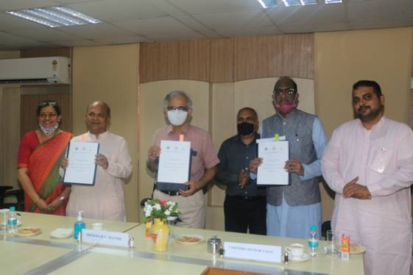
Convergence with CSIR for livelihood creation in rural areas through the diffusion of CSIR rural technologies
To boost livelihood with little and moderate skill sets, especially for rural set-up
Over 40 CSIR technologies demonstrated
In Pilot Phase large number of technology seekers across the states of Gujarat, Uttar Pradesh Uttarakhand, Manipur, and West Bengal exploring the implementation of one or more CSIR technologies in villages they operate in
Design of technology implementation plans for 16 CSIR technologies
Diffusion of rural technologies developed by CSIR for societal benefits through UBA network
Technology pitching and demonstration events for garnering stakeholder interest
MoU signing ceremony; July 28, 2020
Planning, implementation, capacity-building monitoring and evaluation through UBA network
Conceptualization of National Rural Technology Demonstration Centers
Conceptualization of National Rural Innovation Facility for Skills and Rural Entrepreneurship Development
Technology demonstration event; March 19, 2021

Slide 18

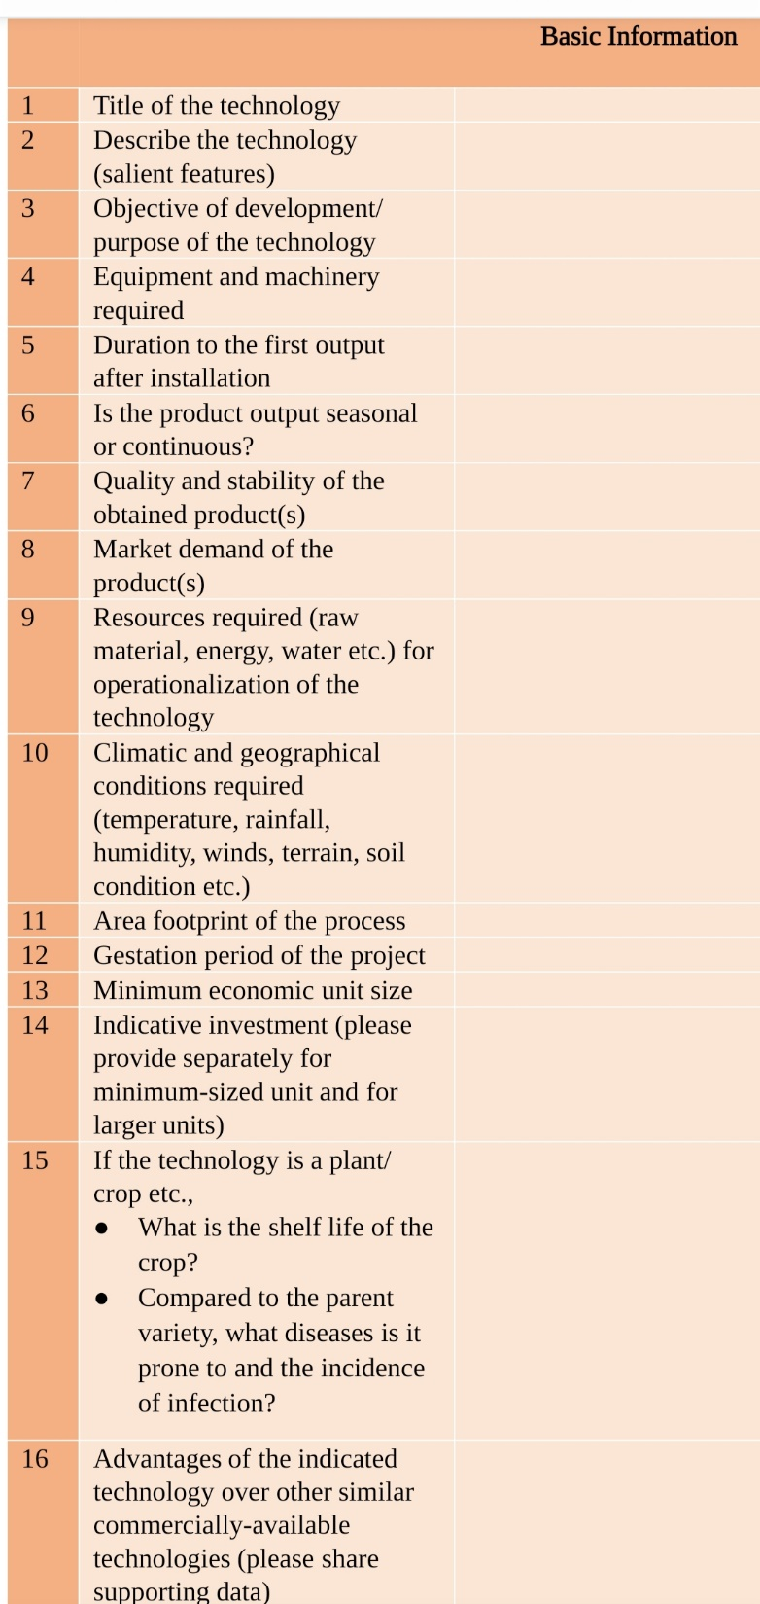
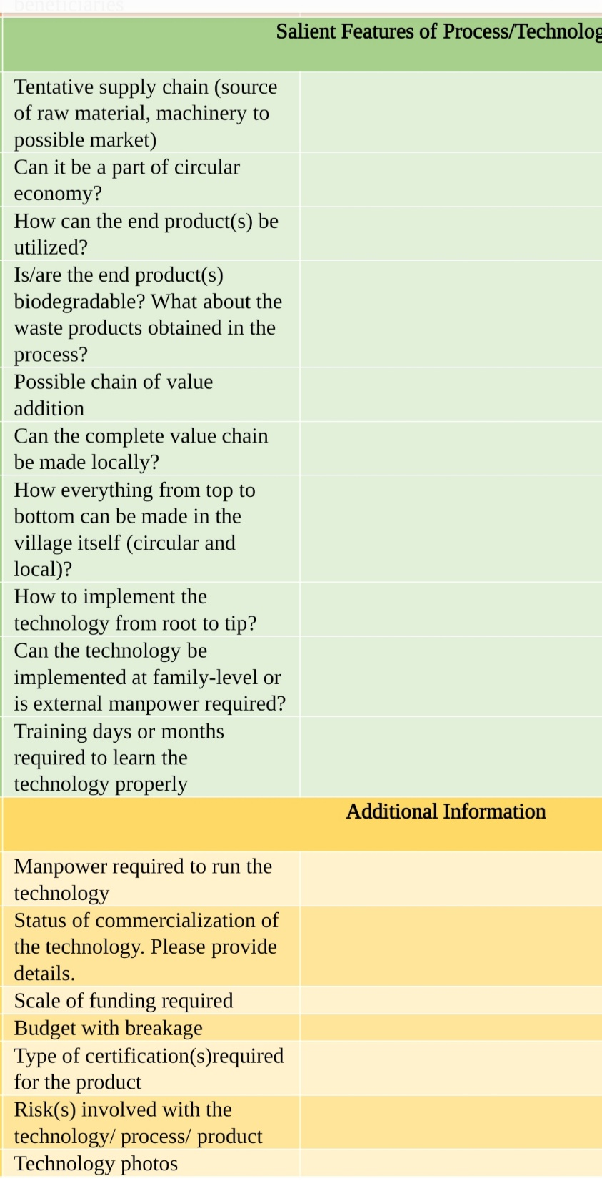
Achievements
Framework for assessment of the suitability of CSIR technologies for deployment in select geographies (work in progress)
Launched by Shri Jitendra Singh, Hon’ble Union Minister of State of the Ministry of Science and Technology and the Ministry of Earth Sciences on January 14, 2022

Slide 19
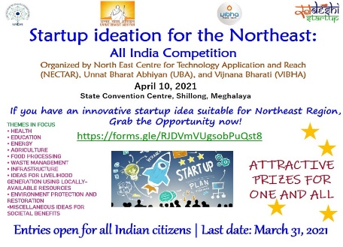
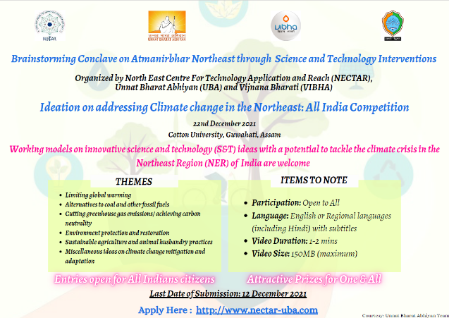
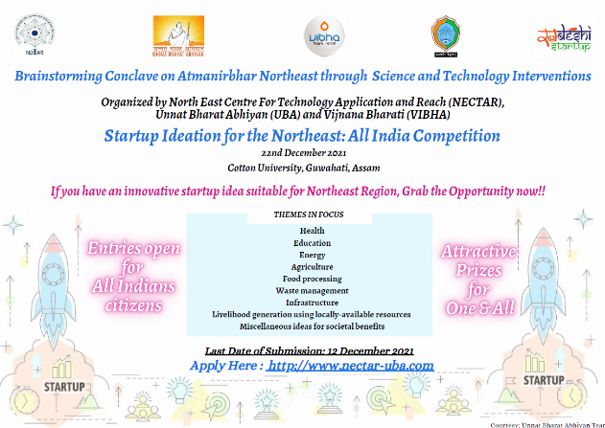
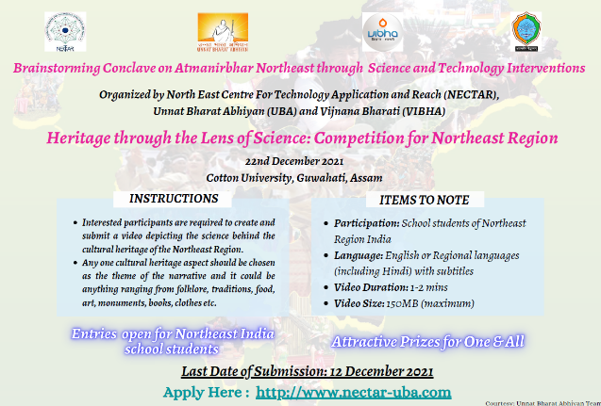
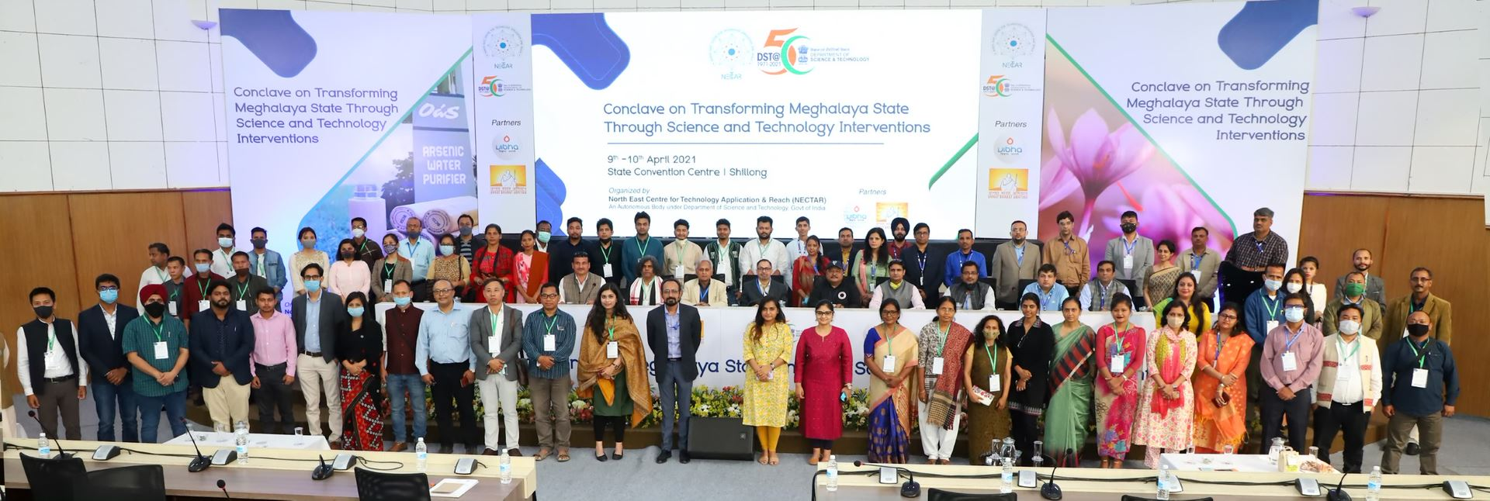
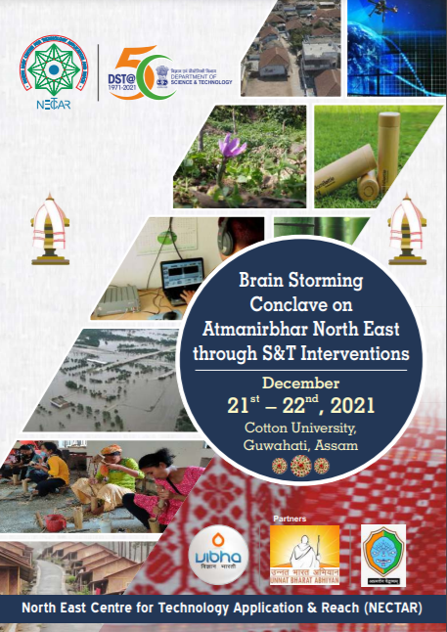
Convergence with DST-NECTAR for livelihood creation in Northeast Region through S&T interventions
To boost livelihood of people in the North East Region
S&T interventions employing local resources relevant for rural population
Planning, implementation, capacity-building monitoring and evaluation through UBA network
MoU signing ceremony; March 3, 2021
Brainstorming conclave; December 21-22, 2021
Technology conclave; April 9-10, 2021
Establishment of National Rural Technology Demonstration Centers
Establishment of National Rural Innovation Facility for Skills and Rural Entrepreneurship Development
Events to promote technology outreach and garner stakeholder interest

Slide 20
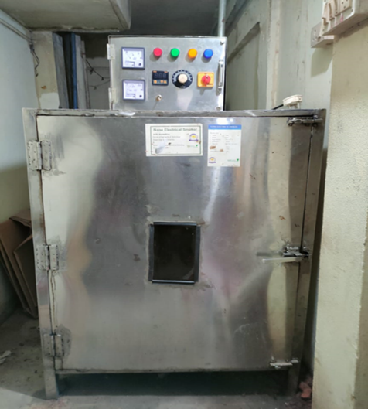
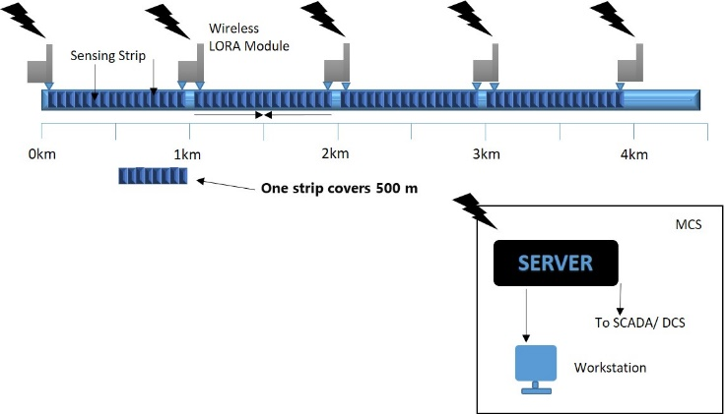
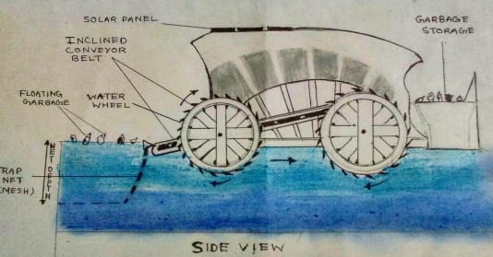
Achievements
2 startup events and 2 technology conclaves organized in collaboration with NECTAR
4 startup projects mentored by UBA for implementation in rural areas of Northeast
Ban Ghor
Pipeline leakage detection system
Business plan for up a pork/fish smoking unit with innovative electric smoker
Jal - Kabadiwalah (A floating garbage collection system for rivers)

Slide 21
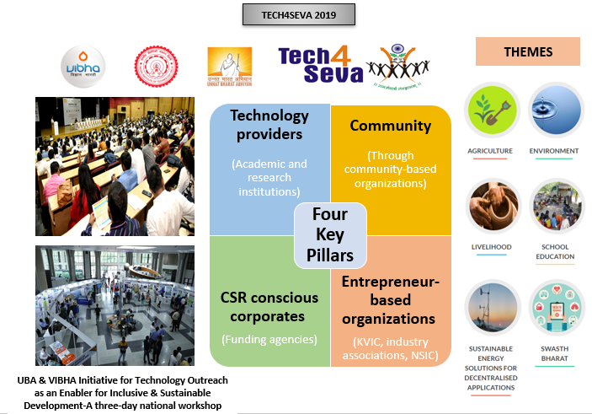


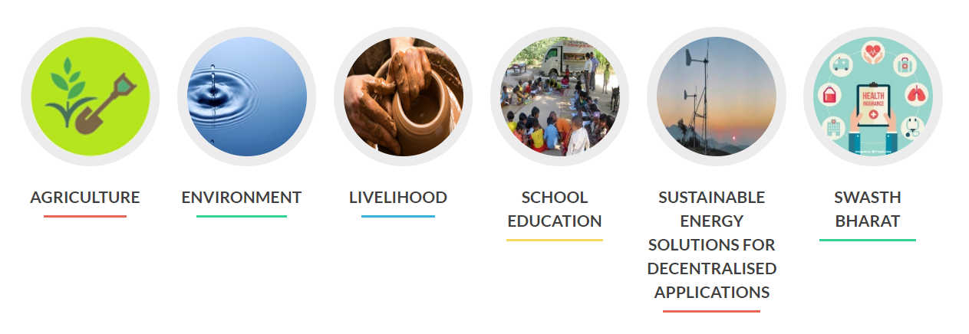
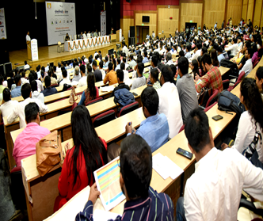
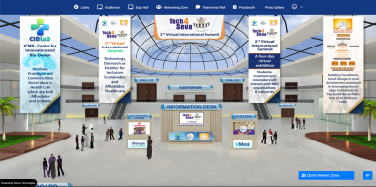

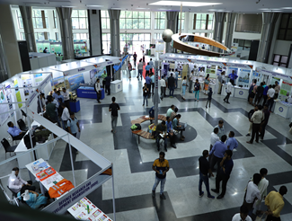
Tech4Seva
Tech4Seva is a tool to bring corporates, research agencies, NGOs, voluntary organizations and grass-roots level practitioners on a common platform to address the national developmental challenges
TECH4SEVA 2019
TECH4SEVA 2021
THEMES
Four-day virtual exhibition was organised as part of the programme. Various technologies developed by prestigious organisations, start-ups, industries and individuals were demonstrated and showcased during this Expo.
THEMES
Environment Friendly and Sustainable Technologies
Atmanirbhar Bharat: Promotion Applied Research into Employment & Entrepreneurship
Affordable
Healthcare
Innovation & Technology
for Health & Wellness

Slide 22

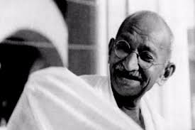
Thank you!

